Slide 1
Ancestry Data Viewer
Winter 18
Midterm Progress Report
By: YongPing Li, Le-Chuan Chang, Monica Sek

Slide 2
Purpose and Goal
Purpose: GEDCOM file is very difficult to read and cluttered with information.
Goal: Create the Ancestry Data Viewer software which read in a GEDCOM file and displays the information onto an ancestry tree.
Functionalities: 2D view, 3D view, lineage view, and find common ancestor between two people
Notes:
YongPing Li
The purpose of our project is because of GEDCOM files are very difficult to read and cluttered with information, so we need a better method of viewing the information inside the GEDCOM file. The goal is to create the ancestry data viewer software which is capable of reading in a GEDCOM file and displaying the information onto an ancestry tree. The software first needs to parse the GEDCOM file to get the information we need. The information is to be displayed with our display algorithm to make sure the ancestry tree is displayed correctly. The UI is to be implemented for interactions with users. The software needs to be capable of displaying the ancestry tree in 2D view, 3D view, and lineage view. Therefore, the software needs to able to detect whether a VR device is connected and if so, change to 3D view. For the direct lineage view, we need to be able to find the ancestor and descendants of a given person. The find common ancestor function is simple once we can identify ancestors of a given person.
1:20

Slide 3
Parser
The application needs to read through a GEDCOM file to find the id and names of people and then connect them to their relatives.
Process of creating the parser:
Download examples of GEDCOM file
Analyze the structure
Research on the tags
Notes:
As I have said before, the application needs to read through a GEDCOM file to find the ID and names of people and then connect them to their relatives. For implementing the parser, I first search and download examples of GEDCOM files. From there, I analyze the structure of the GEDCOM files. The GEDCOM first start off with some information about the family, and then lots of labels that we do not need, and information about individuals after that. There are two pieces of information that we need from the individual's section and that is some form of identification and their name. Identification is needed because we might have people with the same names in the family. We need to able to distinguish each individual person from others. Identification for individuals already exist in the GEDCOM file, and we don't have to create our own. Eventually, I found tags which I didn't know what meaning of and I went online and did more research. I found a website with detailed information about each tag in the GEDCOM file and successfully identify all the information as well as the tags corresponding to each type of information.
1:37

Slide 4
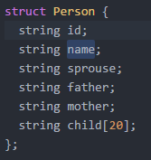
Current stage of the Parser:
Capable of gathering all the needed information
Information is stored in struct array
Individuals are somewhat linked
Function to find the root nodes
Notes:
The parser is implemented and it is capable of gathering all the needed information. The information gathered is stored in a struct array. The struct array contains six variables and that is id, name, Sprouse, father, mother, and child. It is storing information about the individual and names of people who are directly related to the individual. Therefore, the individuals are somewhat linked together, but there are problems doing it this way. First of all, there can be duplicate names in the family which will cause problems. If we change the fields from storing names to storing the identification of individuals could fix this problem but it makes names more difficult to access. Therefore, I will start implementing the tree structure for storing the information which is more easier to access. I have implemented a function inside the parser to find the root nodes of the ancestry tree. The root nodes are on top of the family tree and their parent's information doesn't exist in the GEDCOM file. Therefore, the husband and wife with no information about their parents are the root nodes. This will be helpful in displaying the ancestry tree. I will start working on the display after I get the tree structure implemented.
1:33

Slide 5
Algorithm
The algorithm was designed without having looked at the GEDCOM file. As such, the algorithm was redesigned around the family portion of the GEDCOM file.
The algorithm has not been implemented yet.

Slide 6
UI
The UI for VR is planned to be a menu attached to the user’s hand.
The UI for 2D mode is planned to be similar to other programs, like word, with an additional location to indicate a maximum of two selected nodes

Slide 7
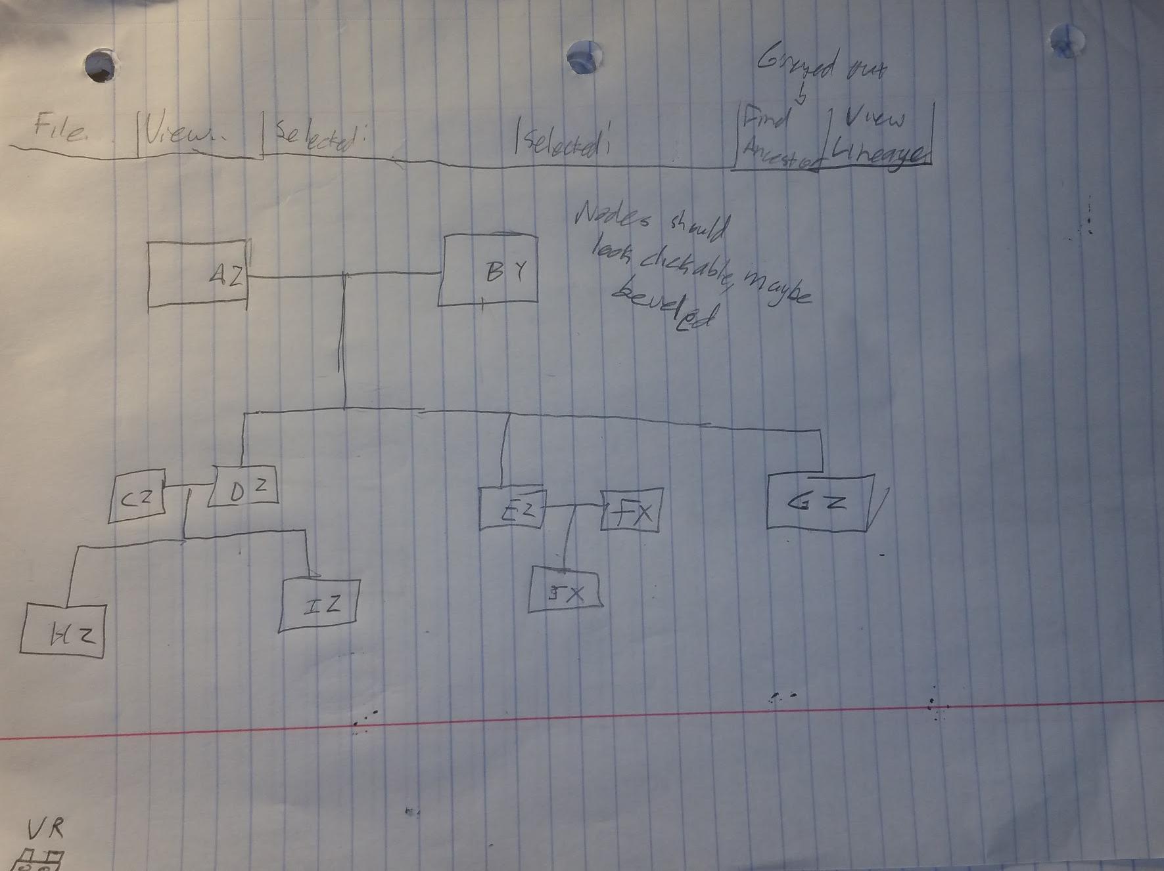
2D Design 1

Slide 8
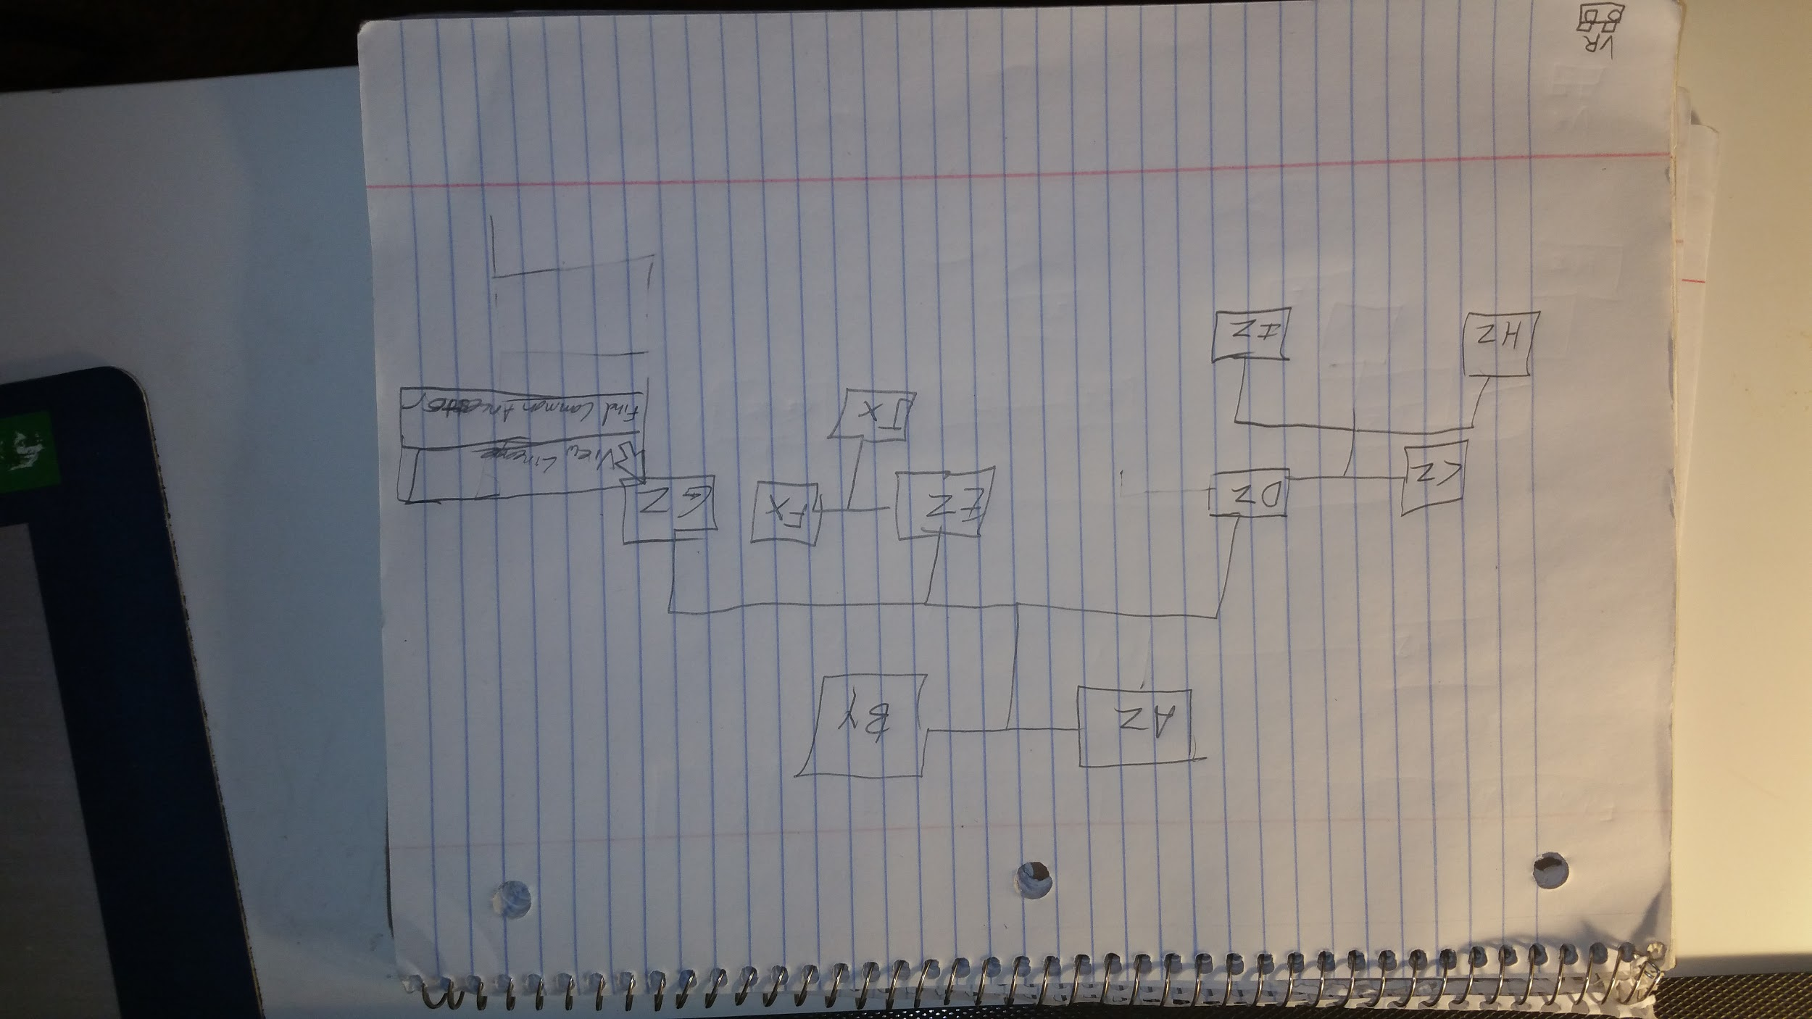
2D Design 2

Slide 9
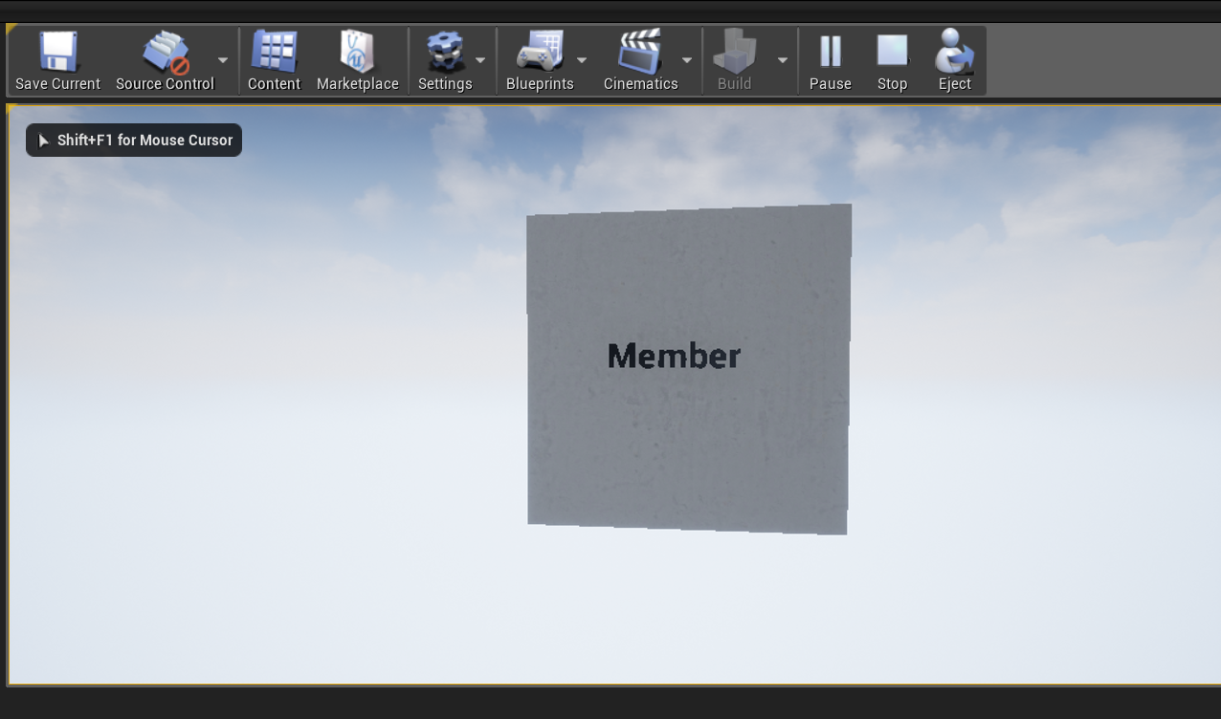
Display
Notes:
Monica
On the Unreal Engine, we’ve begun constructing classes and objects for our application. Members of the family tree will have their names placed onto an object as shown on the screen. The text and the object will be bound together, this will make duplicating and manipulating the nodes for each family member easier and faster. Using the built-in texture pack in Unreal Engine, I attempted to make a basic object for the node, currently the node will be displayed as a rectangular 3d object. Further development will be applied to make it look more appealing such as beveled edges and possibly a smoother texture pack. This object will be interactable to the user, as mentioned before. The user is also able to scroll across the screen, and to zoom in and out of the tree. Boundaries have been applied to the camera so users won’t venture too far off from the ancestry tree. Overall, this is the most basic design of a single node which we will use as a base to build the rest of the ancestry tree.
(1m 4s)

Slide 10
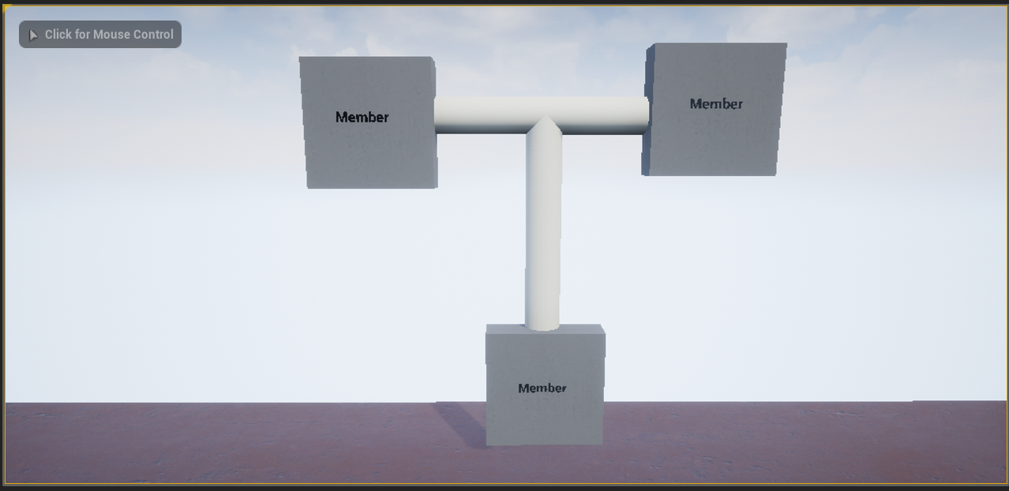
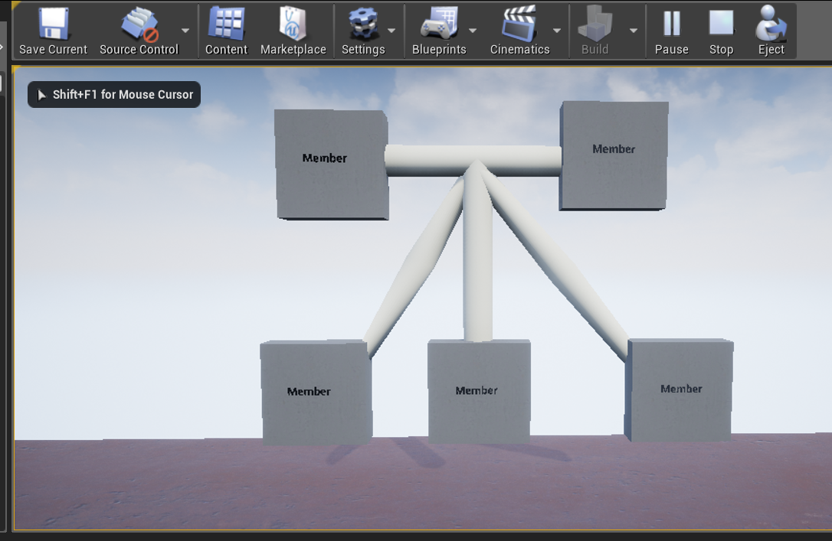
Display
Notes:
Monica
As shown on screen, the nodes will be connected to each other with pipelines. Originally I attempted to use a basic cylinder shape object, but it did not allow me to manipulate it as easily as I had hope. After researching online for an alternative solution, I found a blueprint that helped me create a spline pipeline out of mesh texture. This allowed easier manipulation with connecting the nodes with a pipe, giving it the ability to bend the pipeline allows it to appear more flexible and not as rigid. Although my current implementation of it is a bit glitchy and slightly jagged. This component will be seen when a larger ancestry tree is being displayed and contain more relationships between nodes. The construction of the spline pipelines through blueprints will be discussed further in the next slide. Solid pipelines will be shown connecting married couples, a dotted pipeline will be implemented to represent couples who have divorced. From the marriage pipeline, more pipelines will emerge from it to match the amount of offsprings that the couple has had together. Again, nodes will be interactable. Upon being clicked, the node selected will be highlighted as well as their relationship pipelines to other members of the family. These interaction features will all be incorporated into their object classes, thus allowing all object to share the same behavior. The floor seen on screen was placed there to help debug certain things, it will be taken out so users will only see a data tree suspended in air. Light source objects will be take off, so shadows seen in the screenshots won’t be implemented.
(1m 24s)

Slide 11
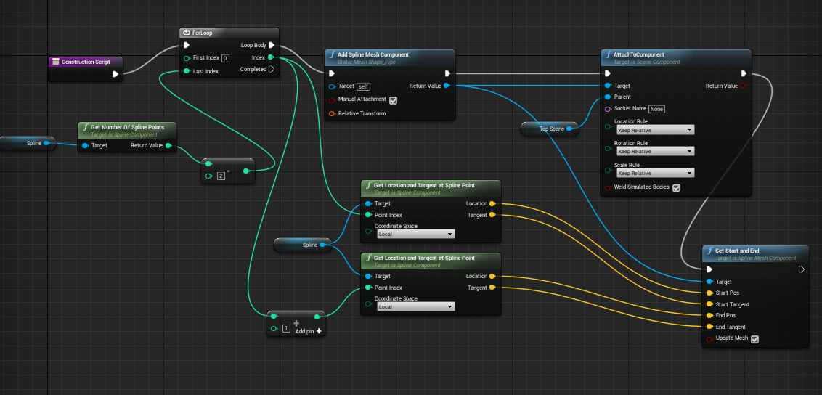
Creating object files
Notes:
Monica
As mentioned in the previous slide, we are using the Unreal Engine built-in blueprint function. The one shown on screen was used to implement the spline pipeline functionality. This was done by creating meshes between certain node points. Additional points is allowed, however this is only through manual insertion. To implement this into our application, we will need it to automatically create node points based on distance and how close it is to other objects when displaying the ancestry tree. Since I am unfamiliar with Unreal Engine and the blueprint application, it was tricky to build at first. But thanks to online documents and forums, I have gathered many useful open source data files for blueprints. We will use these blueprints to create smoother texture packs for the objects. It will also be used to access other functions in our application such as toggling between direct and full ancestry view, and finding the common ancestor between two selected members. The blueprints will allow us to transition into the other features upon selection. C++ coding will be used to create the algorithm for each feature. All the features will use the same object classes, this means node objects and pipelines will follow the same rules throughout each feature. Finally, another blueprint we would use would be the ability to transfer our desktop application into VR mode.
(1m 27s)

Slide 12
To Do List
Try to incorporate our parser into Unreal Engine
Attach parser data to objects in Unreal Engine
Fix spline manipulation on pipes
Integrate buttons for functionality
Begin initializing functionality
Transfer into VR
Notes:
Monica
Our next course of action would be to implement our parser into Unreal Engine. Unreal is able to take in C++ coding so hopefully the parser integrates into our application without a problem. Once we implement the parser code, we will be able to attach the parsed data to the objects in Unreal Engine. This means members will be generated as their own unique object nodes, with a text attached to them displaying their names, and they will be connected by spline pipelines which will connect them by their determined relationship with one another. However, there is a small glitch with the spline pipelines and adding mesh points wrong, which causes an additional pipe to emerge from the original pipeline. Using older blueprints has been a challenging factor because many of them might not be completely applicable with the current version of Unreal Engine. Once the main display is completely implemented, we will be able to integrate a menu bar and buttons for extra feature functionality. The menu bar will be a static window and fit the screen regardless of how the user interacts with the data tree. Extra feature functionality includes toggling between direct and full tree view, finding a common ancestor between two nodes, and finally entering VR mode. Toggling between the direct and full tree feature will be initiated by selecting a member and then clicking on direct lineage. The application will then display all of their ancestors nodes above the selected member so that they are being displayed as a full binary tree (or at least as record allows) where each node is attached to two parents. The common ancestor function will be initiated when the user clicks on the corresponding button, then they will be able to manually select two members of their choice. Then their common ancestor will be highlighted and along with the pipeline pathway to the selected members. Once we have accomplish all the features on the desktop application, we will transfer it over into a VR application. Since the functionality of the features are the same and the objects are already created to be 3D, the transition should not be too much of a difference. The biggest change would be interacting with the nodes in VR. As mentioned earlier, instead of having a menu bar, the user will be able to access the menu through the VR controller. Scrolling across the screen and zooming in and out will still apply for the user, however they won’t be able to pass a certain point. This way they don’t venture off too far and don’t physically interfare with the ancestry tree objects.
(2m 45s)

Slide 13
To Do List
UI assets, functionalities, integrate
Create selected node system
Create display algorithm
Implement display algorithm with Unreal
Find VR hand asset for VR UI
Implement hand pointing for selection
Perform aesthetics and usability testing for UI
Notes:
51s

